Slide 1
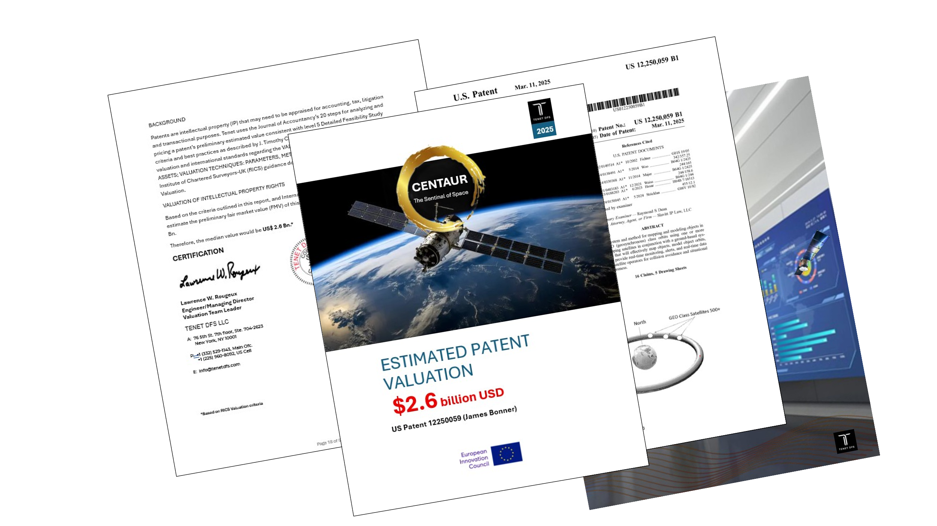
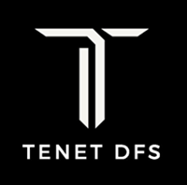
Centaur Space: Preliminary Finance Strategy
Sources
Financial Instruments:
Convertible Debt and/or Project Finance Non-Recourse Loan using Patent & ECA Loan guarantees to securitize the Debt.
U.S. PATENT
Leverage Patent for Financing
E. I. C.
Creative Destruction Lab (CDL):
A global, non-profit, seed-stage program designed to help science- and technology-based startups scale into massively successful companies using an intensive, 9-mo., objectives-based mentorship program.
The CDL Model:
Mentorship, No fees, No equity,
Objective Based, Deep Tech Focus, Global Network, Success Metrics. For technical founders with strong IP but lack the business experience to commercialize their innovation.
Blended Finance
INVESTORS
European Defense Fund,
ESA, Thales-Alenia. Snowfox
Phased Development Timetable:
Phase 1: Immediate Action & De-risking (Q3 -Q4 2025)
Phase 2: Grant & Financing Application (Q1 - Q2 2026)
Phase 3: Capital Raise & Scaling (Q3 2026 Onwards)
Technical Assistance
World Bank Group, et al

Slide 2

Preliminary Budget: 300 M USD
Build Cost:
Launch Cost:
Insurance
100 M EURO
100 M EURO
15 M EURO
Operations:
Notes:
Consistent with NASA Procedural Requirements (NPR 7120.5), we suggest a contingency reserve of 20% be provisioned to accommodate technical, schedule, and programmatic uncertainties inherent in early-phase satellite development. This allocation reflects standard practice for Pre-Phase A through Phase B planning and will be refined as design maturity and risk posture evolve. The reserve is to ensure financial resilience against scope changes, procurement delays, and emergent technical risks. This reserve is benchmarked against NASA’s cost reserve guidance and is intended to preserve project viability under adverse conditions. This reserve can be ring-fenced and governed by a drawdown protocol approved by a Project Steering Committee, with periodic review based on risk reassessment and milestone progress. This reserve is consistent with NASA’s historical cost modeling for comparable satellite missions and supports a 70% confidence level in budget adherence.
10 M EURO
Professional Fes::
5 M EURO
50 M Euro
Cost Reserve: 20%
Set up as a line of credit
Centaur Space, Inc. / James Bonner

Slide 3
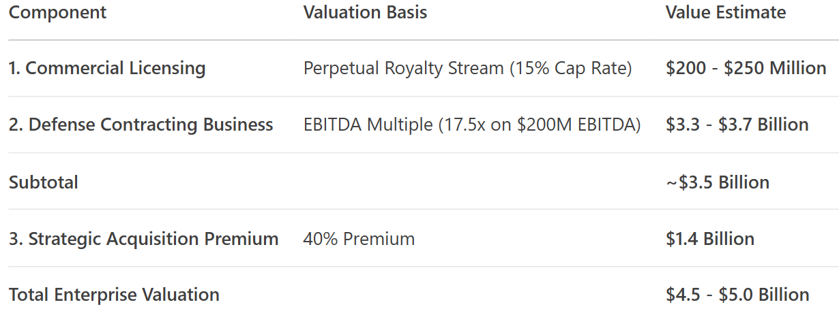



Valuation Framework: Centaur Space
De facto Industry Standard & Critical National Security Importance Basis
Market Share: 80-90%. As the standard, almost every commercial satellite operator in GEO must use this service to ensure the safety of their assets and maintain orbital safety.
Royalty Base: 450 satellites (90% of 500) * $300M asset value = $135 Billion in protected assets. Valuation: $225 M
U.S. Space Force / Space Command, NASA Orbital Debris Program Office, European Space Agency (ESA), UK, French, German, and other national defense agencies. Valuation: $3.5 Bn
Critical strategic advantage in space domain awareness cannot be owned by a company that could be sold to a foreign adversary. This asset would be considered vital national infrastructure. Companies like Lockheed Martin Space, Northrop Grumman, Raytheon Technologies, L3Harris Technologies will likely want to acquire at a 30% to 50% premium above valuation. The commercial licensing value is classed as a monopoly/standard with lucrative, high-multiple earnings from classified and non-classified defense contracts.
The Commercial Licensing Business
Contract Structure: This would not be a royalty. It would be a series of lucrative cost-plus or fixed-price contracts to build, launch, and operate a constellation of these monitoring satellites exclusively for government use.
Revenue Potential:
  A single major defense contract can be worth $500 million to $2 billion+.
  This is not annual royalty income; this is major contract revenue flowing directly to Centaur Space Inc.
Valuation (Defense Business): Valuing a defense contractor is typically based on a multiple of earnings (EBITDA). If Centaur wins a $1 billion contract with a 20% profit margin ($200M EBITDA), and similar defense tech companies trade at an EBITDA multiple of 15x-20x, this part of the business alone could be worth:
  $200M EBITDA * 17.5x Multiple = $3.5 Billion.
Potential Government Defense Contracts
The Strategic Premium
Market Share: 80-90%. As the standard, almost every commercial satellite operator in GEO must use this service to insure their assets and ensure orbital safety. Royalty Base: 450 satellites (90% of 500) * $300M asset value = $135 Billion in protected assets. Annual Service Fee: 0.5% of asset value = $675 Million in total service revenue. Centaur's Royalty: At a dominant 5% rate, annual royalty income = $33.75 Million. Discount Rate: As the undisputed industry standard, the technology and execution risk plummet. The market risk is gone. We can now use a discount rate reflective of a stable, utility-like business. Let's use 15%. Valuation (Commercial): Capitalizing this perpetual stream of income: $33.75M / 0.15 = $225 Million. | Market Share: Not 20%, but 80-90%. As the standard, almost every commercial satellite operator in GEO must use this service to insure their assets and ensure orbital safety. Royalty Base: 450 satellites (90% of 500) * $300M asset value = $135 Billion in protected assets. Annual Service Fee: 0.5% of asset value = $675 Million in total service revenue. Centaur's Royalty: At a dominant 5% rate, annual royalty income = $33.75 Million. Discount Rate: As the undisputed industry standard, the technology and execution risk plummet. The market risk is gone. We can now use a discount rate reflective of a stable, utility-like business. Let's use 15%. Valuation (Commercial): Capitalizing this perpetual stream of income: $33.75M / 0.15 = $225 Million.
Market Share: Not 20%, but 80-90%. As the standard, almost every commercial satellite operator in GEO must use this service to insure their assets and ensure orbital safety. Royalty Base: 450 satellites (90% of 500) * $300M asset value = $135 Billion in protected assets. Annual Service Fee: 0.5% of asset value = $675 Million in total service revenue. Centaur's Royalty: At a dominant 5% rate, annual royalty income = $33.75 Million. Discount Rate: As the undisputed industry standard, the technology and execution risk plummet. The market risk is gone. We can now use a discount rate reflective of a stable, utility-like business. Let's use 15%. Valuation (Commercial): Capitalizing this perpetual stream of income: $33.75M / 0.15 = $225 Million. | Market Share: Not 20%, but 80-90%. As the standard, almost every commercial satellite operator in GEO must use this service to insure their assets and ensure orbital safety. Royalty Base: 450 satellites (90% of 500) * $300M asset value = $135 Billion in protected assets. Annual Service Fee: 0.5% of asset value = $675 Million in total service revenue. Centaur's Royalty: At a dominant 5% rate, annual royalty income = $33.75 Million. Discount Rate: As the undisputed industry standard, the technology and execution risk plummet. The market risk is gone. We can now use a discount rate reflective of a stable, utility-like business. Let's use 15%. Valuation (Commercial): Capitalizing this perpetual stream of income: $33.75M / 0.15 = $225 Million.
Market Share: Not 20%, but 80-90%. As the standard, almost every commercial satellite operator in GEO must use this service to insure their assets and ensure orbital safety. Royalty Base: 450 satellites (90% of 500) * $300M asset value = $135 Billion in protected assets. Annual Service Fee: 0.5% of asset value = $675 Million in total service revenue. Centaur's Royalty: At a dominant 5% rate, annual royalty income = $33.75 Million. Discount Rate: As the undisputed industry standard, the technology and execution risk plummet. The market risk is gone. We can now use a discount rate reflective of a stable, utility-like business. Let's use 15%. Valuation (Commercial): Capitalizing this perpetual stream of income: $33.75M / 0.15 = $225 Million. | Market Share: Not 20%, but 80-90%. As the standard, almost every commercial satellite operator in GEO must use this service to insure their assets and ensure orbital safety. Royalty Base: 450 satellites (90% of 500) * $300M asset value = $135 Billion in protected assets. Annual Service Fee: 0.5% of asset value = $675 Million in total service revenue. Centaur's Royalty: At a dominant 5% rate, annual royalty income = $33.75 Million. Discount Rate: As the undisputed industry standard, the technology and execution risk plummet. The market risk is gone. We can now use a discount rate reflective of a stable, utility-like business. Let's use 15%. Valuation (Commercial): Capitalizing this perpetual stream of income: $33.75M / 0.15 = $225 Million.
Market Share: Not 20%, but 80-90%. As the standard, almost every commercial satellite operator in GEO must use this service to insure their assets and ensure orbital safety. Royalty Base: 450 satellites (90% of 500) * $300M asset value = $135 Billion in protected assets. Annual Service Fee: 0.5% of asset value = $675 Million in total service revenue. Centaur's Royalty: At a dominant 5% rate, annual royalty income = $33.75 Million. Discount Rate: As the undisputed industry standard, the technology and execution risk plummet. The market risk is gone. We can now use a discount rate reflective of a stable, utility-like business. Let's use 15%. Valuation (Commercial): Capitalizing this perpetual stream of income: $33.75M / 0.15 = $225 Million. | Market Share: Not 20%, but 80-90%. As the standard, almost every commercial satellite operator in GEO must use this service to insure their assets and ensure orbital safety. Royalty Base: 450 satellites (90% of 500) * $300M asset value = $135 Billion in protected assets. Annual Service Fee: 0.5% of asset value = $675 Million in total service revenue. Centaur's Royalty: At a dominant 5% rate, annual royalty income = $33.75 Million. Discount Rate: As the undisputed industry standard, the technology and execution risk plummet. The market risk is gone. We can now use a discount rate reflective of a stable, utility-like business. Let's use 15%. Valuation (Commercial): Capitalizing this perpetual stream of income: $33.75M / 0.15 = $225 Million.

